Slide 1

QER-4252
QER: BID 141KM SF300065C002.2X - Zeta wire weld crack

Slide 2
Pipe section / Details
Item | Traceability / identification
Project number | SF300065C004
Project name | BID 141KM
Pipe section | SF300065C004.2X
ST number | ST10151896
Affected layer / equipment | Zeta spiraling
Length affected | 157.3m
Drawing number / MP code / STA / Dimension | Zeta 6.2 FI09 (MP205)

Slide 3
Overview of anomaly
Problem Description :-
During the zeta spiraling process for BID 141KM SF300065C004.2X (ST10151896), the weld crack was detected at length 157.3m during weld inspection after it was laid on the pipe.
Note that, this affected weld is weld from the winding process.
Details of the defective weld are as the following: -
Length on pipe: 157.3m
Weld No: 7-5
Bobbin no: 014
Root Cause :-
The possible root cause for the zeta weld crack was welding preparation.
Machine setting root cause is ruled out based on graph comparison of crack weld and subsequent weld. No anomaly was found.
Problem Handling:-
These 2 welds N-1 and N+1 have been retrieved and tested for tensile test. The results of tensile for these two welds were accepted.

Slide 4
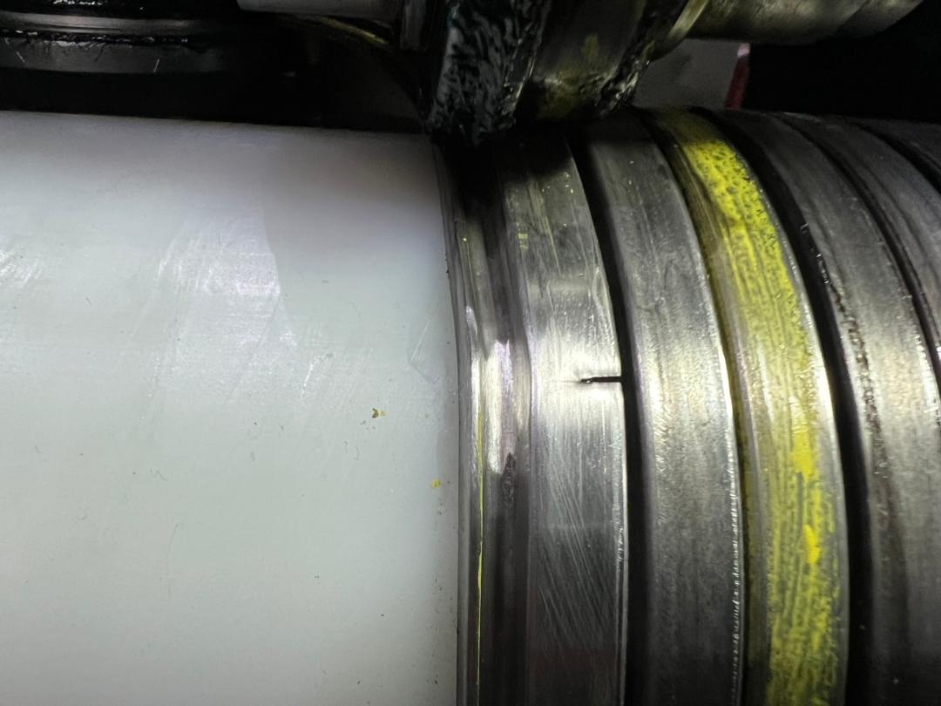
Defect Photo
Figure 1 : Weld crack was detected at length 157.3m during weld inspection after it was laid on the pipe.

Slide 5
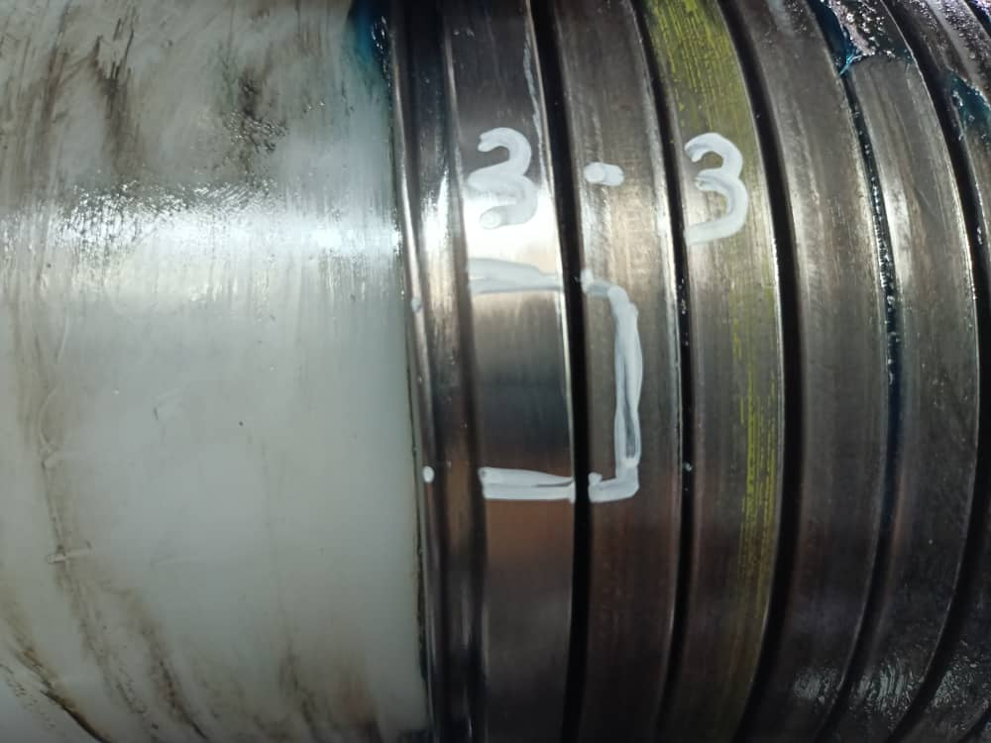
Replaced weld
Figure 2 : The defective weld was rejected according to DP-QCP-08DAQT001. Therefore, the un-spiraling was then performed to remove the defective weld.

Slide 6

THANK YOU

